Slide 1


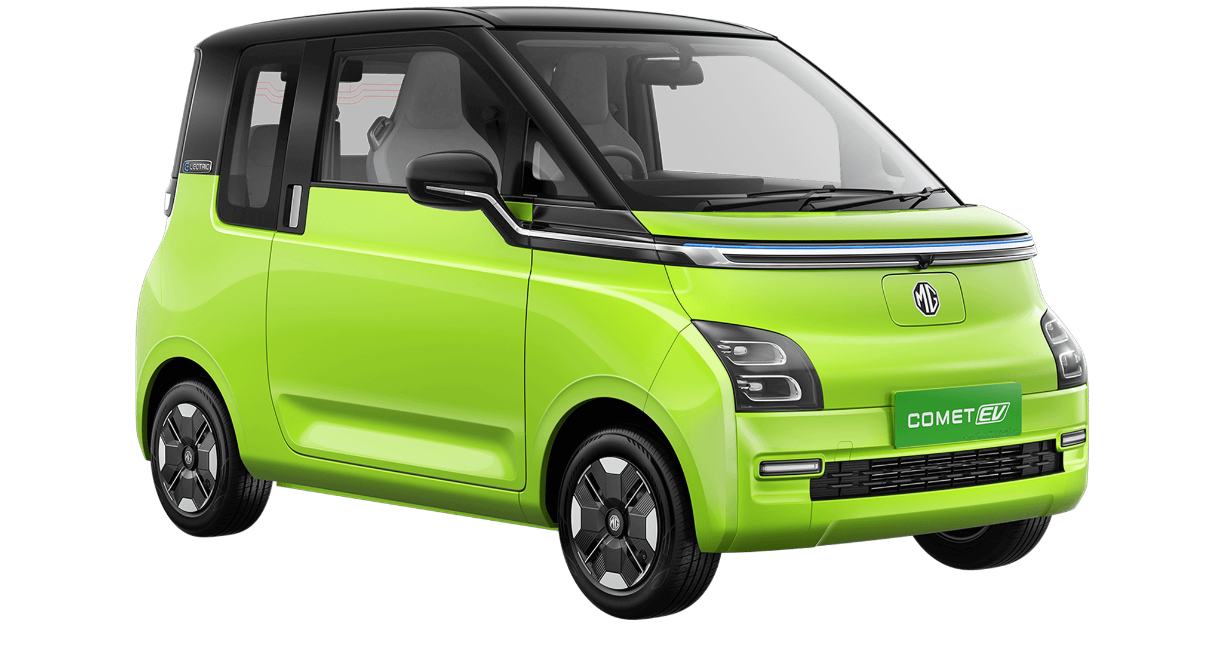
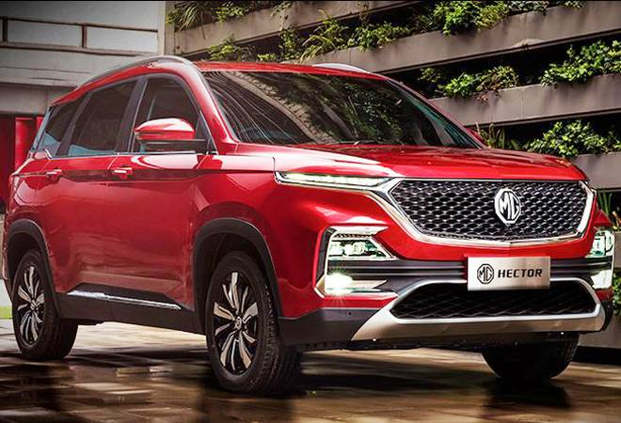
Mg comet ev
“THE NO-NONSENSE CAR”

Slide 2
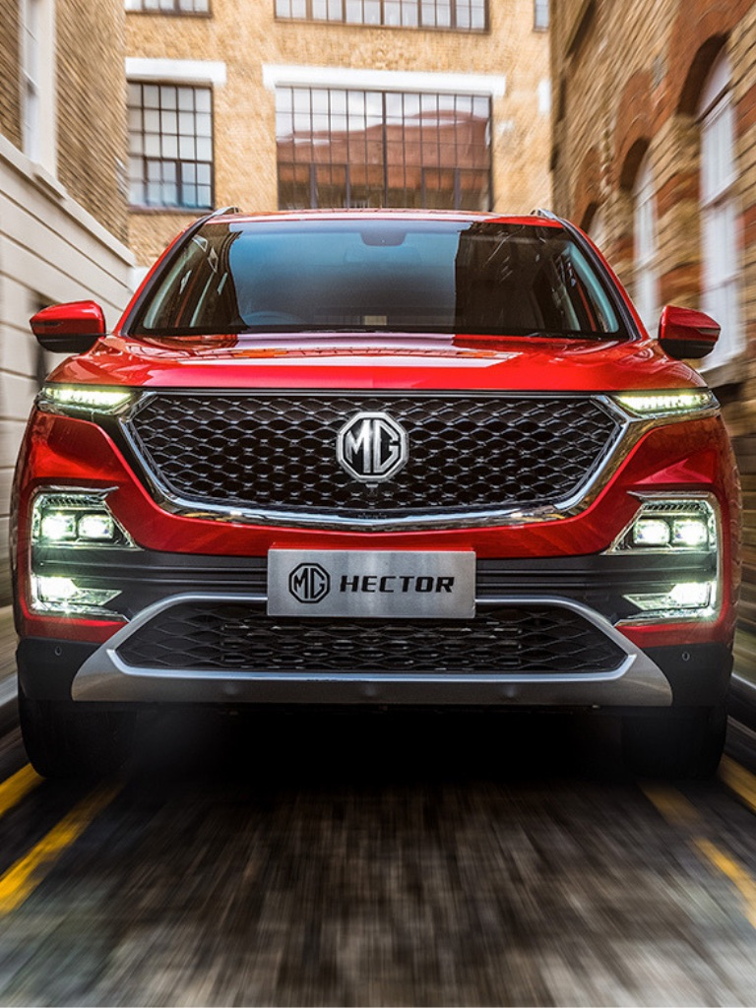
About us
A million speeding lines, a 94 year old legacy, a look out for the future, our fingers on the pulse of innovation, poetic particles in constant motion, we are shapeshifting and transforming constantly. We have broken land speed records, we are a British fashion icon but also pop culture’s best mate. There’s just no staying idle for us. The greatest thing we did yesterday is so yesterday. And we’ll be damned, if we can’t speed away from it just like a flash of blinding light, speeding and transforming. Because while we believe that what we are today is great, we know, tomorrow will be greater.
We’re MG. Welcome to the world of motoring.

Slide 3
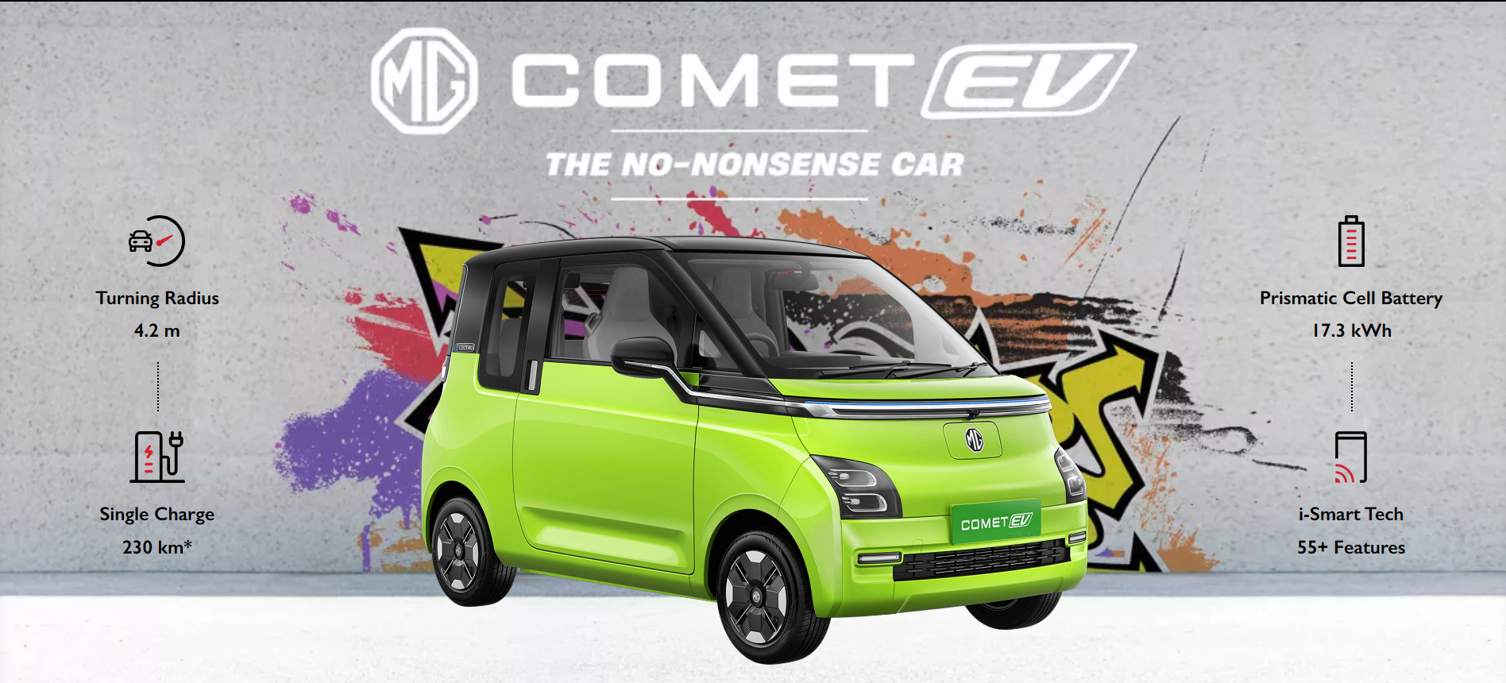

Slide 4
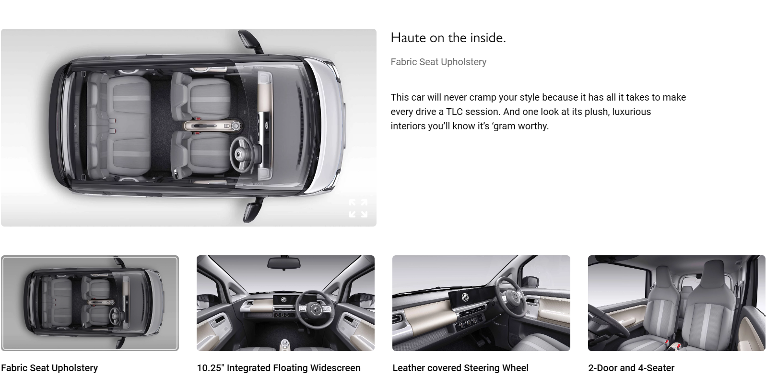
Features

Slide 5
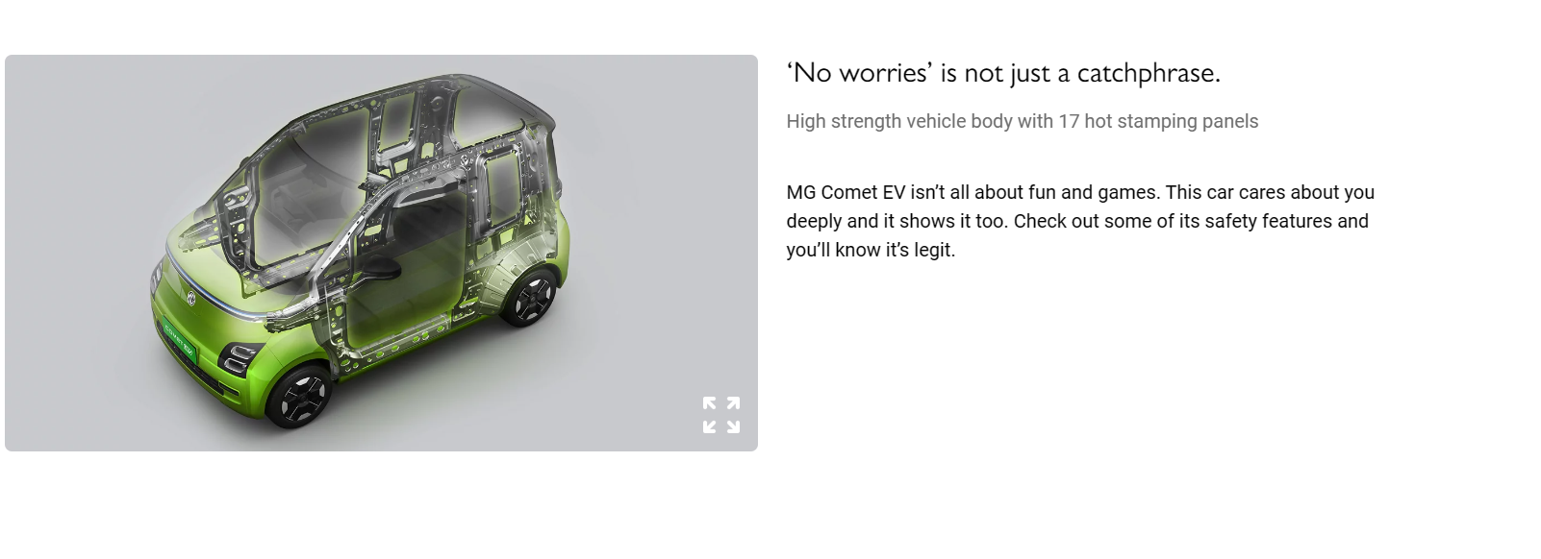
safety

Slide 6
Technology
Tech OP in the Car
Wireless Android Auto & Apple Carplay
MG Comet EV is Savvy enough to keep up with your daily needs on every drive. And with its range of cool connected features, you can get your car to do exactly what you want minus the hassles.

Slide 7
COMFORT
Level of Comfort – Very High
Steering mounted audio controls
Isn’t it sweet when someone takes care of all your needs? That’s exactly what MG Comet EV does with its unique features that make your life a little easier.

Slide 8
BATTERY
Powering your drive IP67 Rated Battery
With the 17.3 kWh Prismatic Li-ion battery, MG Comet EV powers your drive for the long run. So be it those long drives in the rain or everyday hustle to your office, you are always sorted.

Slide 9
PERFORMANCE
Range that’s perfect for the city and you!
The MG Comet EV needs just one charge to travel 200 kms. Which means, the car can take you all around the town several times over, without a break.

Slide 10


Slide 11
THANK YOU!
Have a nice day.

